Slide 1
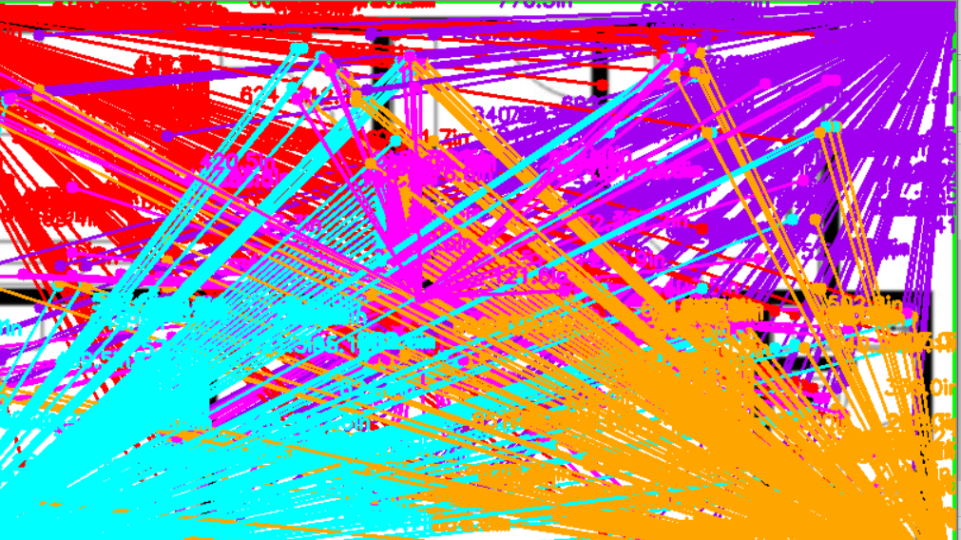
Image Processing and Object detection:
: Reetu Singh

Slide 2
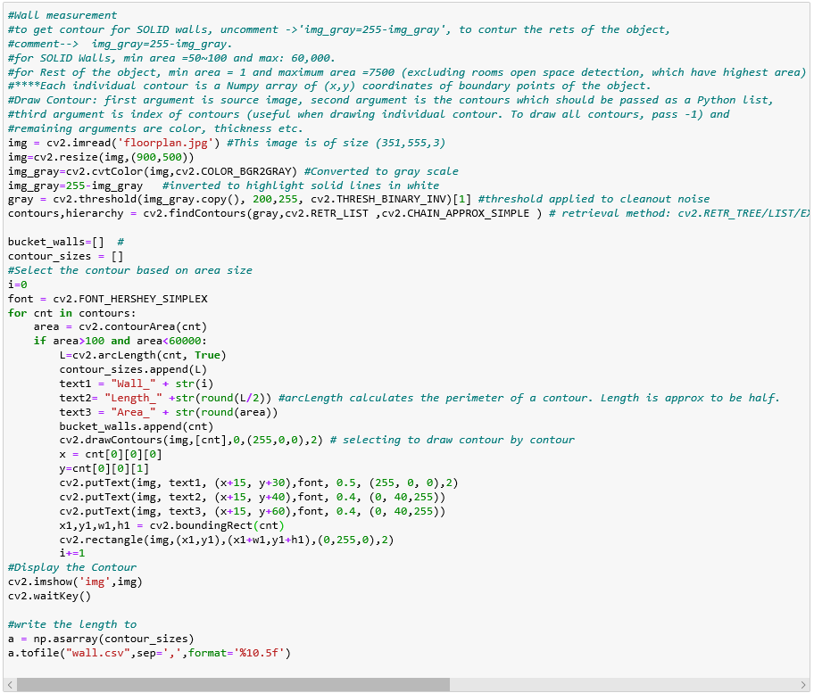
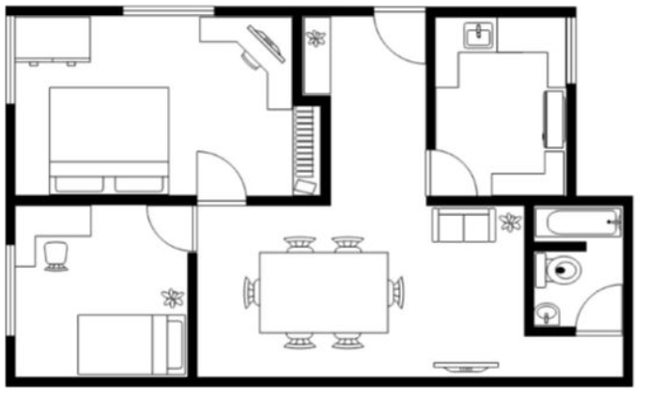
Q1. Wall Measurement
Given a floor plan: export the length of all the walls in a CSV. The above given figure is just an example figure, you can choose any floor plan.
Ans:
In absence of details, assumptions were made. In the given floorplan design, solid lines in black are seen. Length of these solid lines are calculated.
The solution is developed on Python, using mainly Opencv, Numpy and csv Library.
To make the measurement, contour methods are used and imported to csv file.
Using OPENCV ‘ arclength’ function, perimeter is calculated.
Length is approximated to be half of the perimeter, though only perimeter is exported to csv, however in the image. Walls are Labelled with Length and areas , as well.
Find all the material posted herein https://github.com/reetu20202/FloorPlanObjectDetection

Slide 3
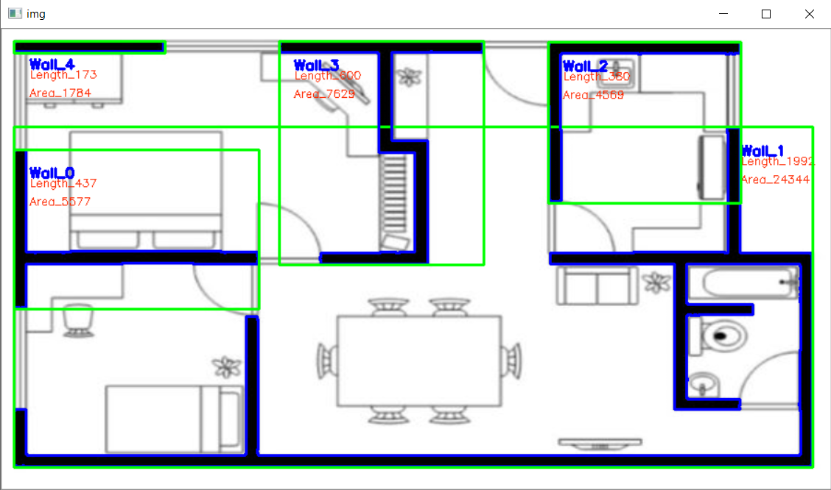
Q1. Wall Measurements
Steps taken:
Load the image
Convert it in gray scale
Apply threshold on gray image
Apply ‘find contour’ to get the identified objects.
Filter out the small/big objects based on contour area.
Calculate perimeter of the Walls and export it in csv. Length is approx. to be half of perimeter.
Calculate the boundary box on the contour.
Display the contour, Boundary box, Label the Walls, display the Length and Area of each wall.

Slide 4
Q2. Given a floor plan, detect different objects present the floor plan. The object can be door, windows, etc.
ANS: There are several methods to object detection:
Labeling the objects using contour/ bounding box:
Object Detection using Template Matching which can be done without machine learning, using template image.
Object detection using deep learning:
There are models available for doing object detection recognition in an image. For example, the most prominent ones are RCNN, fast RCNN, faster RCNN, mask RCNN, Yolo and SSD. However, most of the them are developed for natural images/Real life images.
In this case, we are working on document images ex floor plans, where we need to detect objects like Windows, flowerpots, dining table, Bed, Computer, sofa, sink, etc.
There are not many model available for the documents type images.
In order to apply deep learning, we need training image labelled with classes (in our case, icons used by architecture software in a floorplan).
I tried to use existing YOLO model ,and loaded pretrained model and weight for document type, with darkflow implementation and however facing import issue with Darflow (https://github.com/thtrieu/darkflow).
In the interest of time, have labeled the objects using contour only.

Slide 5
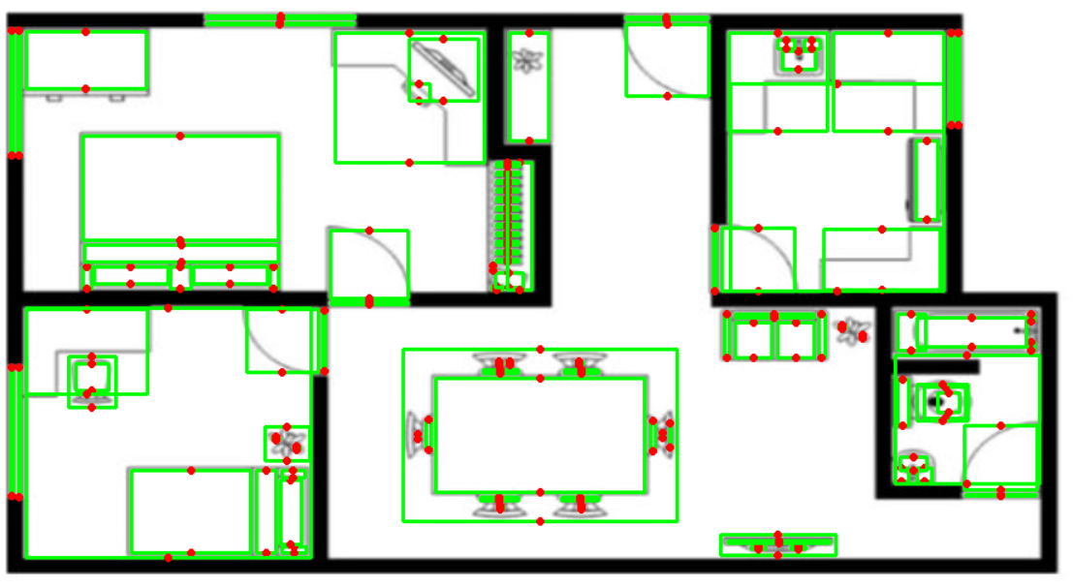
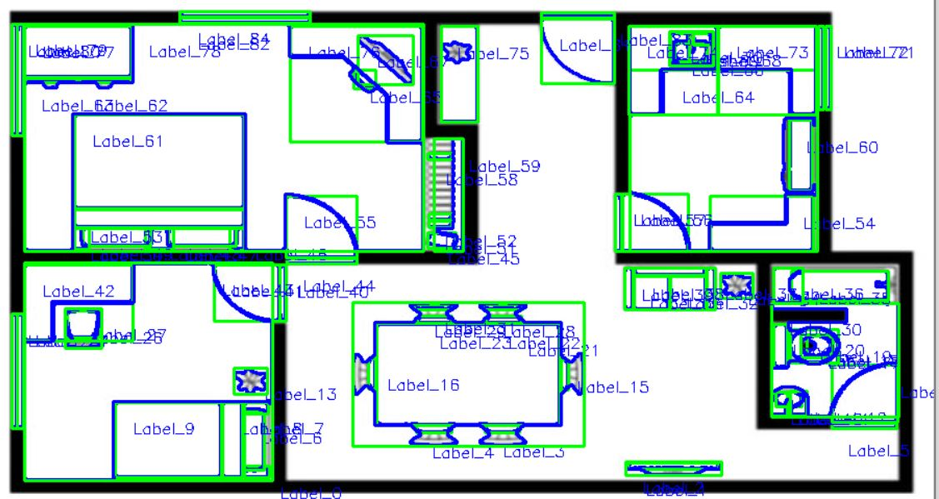
Q2. Given a floor plan, detect different objects present the floor plan. The object can be door, windows, etc.
Steps taken:
Load the image
Convert it in gray scale
Apply threshold on gray image
Apply ‘find contour’ to get the identified objects.
Filter out the small/big objects.
Calculate the boundary box on the contour.
Filter out the noises by adjusting width, height and area of the boundary box.
Display the identified objects on the image.
Object identified with Contour and label

Slide 6
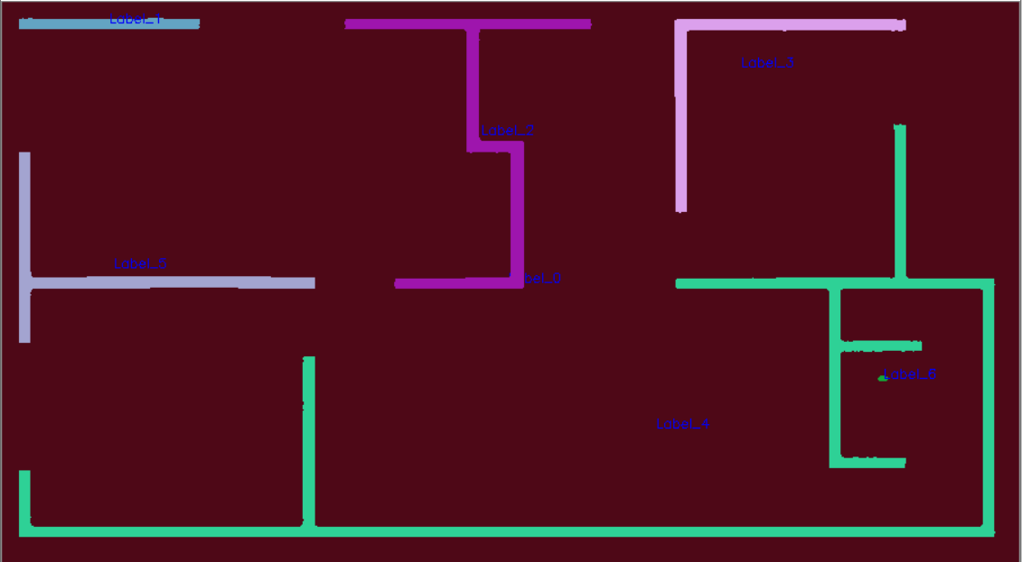
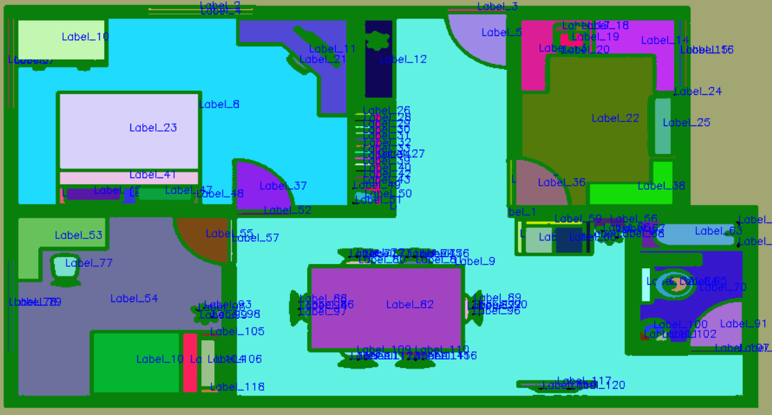
Using Connected components Labeling for Object detection
Identifying Walls
Steps taken:
Load the image
Convert it in gray scale
Apply threshold on gray image
Apply ‘Connected components with stats’ to get the identified object’s Label with coordinates and centroid.
Extract the Label, Stats(coordinate) and centroid of the identified objects.
Get the unique Label and loop through it to collect different objects along with coordinates and centroid.
Display the identified objects and labels on the image
Identifying Objects within Walls

Slide 7
THE END

